Slide 1
Ansible
Configuartion Management Tool

Slide 2
Introduction
Ansible is a configuration management tool with help of ansible we can configure the no.of remote systems from ansible master. And we can deploy the application into no.of of remote servers at a time.
Configuration Management in the sense updating or making some changes to a server like patch update.
Ansible its a like controller-machine and a remote node architecture.
And there is no need to install any third party software or plugin on the remote user.
The only thing we have to do is create the ansible user with password.
And generate ssh-key on controller-machine and copy that ssh-key to all remote machines of your working environment.

Slide 3
why we need Ansible
Ansible is like a tool which will reduces the human-effort at high amount.
Just we need to create a yaml file which consists the code what you want to do make changes in remote machines.
Just Take an example that flipkart announced that there is big billion day on saterday and sunday.
Then automatically the n/w traffic is usually very high for that purpose they need to scale up their servers.
So they took ansible tool for that with help of one single playbook they can increase their environment by providing the hostnames(remote server details) in ansible inventory file.
It’s not the point of remote servers usage after the big billion days. They just want the server for those two days.

Slide 4
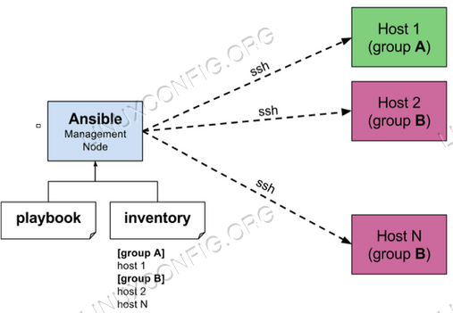
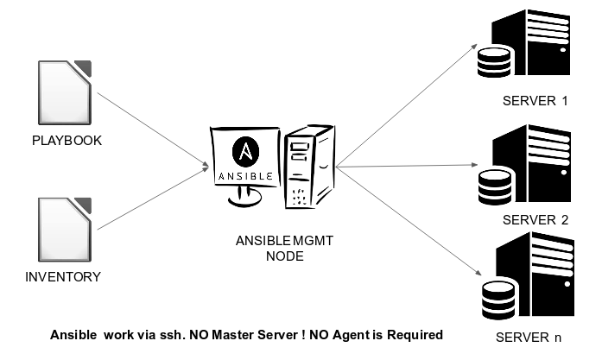
Ansible Architecture

Slide 5
Architecture of Ansible
==> Ansible Architecture consists of one master and no.of node machines.
==>Ansible uses push mechanism.
==>ansible mainly working on ssh process.
==>No need to install any third party software or plugins(agents) on Remote machines.
==>Ansible Requires only One master-agent and no.of remote servers configured within the ansible hosts file(/etc/ansible/hosts)

Slide 6
Ansible Configuration.
To work on Ansible we have to configure the master machine and node machine.
==>Below are the steps we have to follow on master machine.
==>Create a ansible user on both master and node machine with the same name for usability.
==> Even for this we can create a simple playbook and execute on remote raw servers which includes ansible-user creation and ssh-key generation on master and it will be passed to the remote machines.
sudo yum install epel-release
sudo yum install java ansible
Sudo yum install ansible -y
==> once ansible installed sucessfully on your master-machine there will be configuration file will be created under “/etc/ansible” which is ansible.cfg, it is the main configuration file of the ansible.

Slide 7
==> and there we have other file also which is “hosts” which is default inventory file of the ansible master and other thing we can create our own inventory(hosts) files as per our requirement.
==>Just add the remote machines ip address or hostname in the default ansible inventory file.
==> and logged as ansible user and generate a ssh-key on your master and generate a ssh-key by using “ssh-keygen” command and then copy that key to remote machines by using
“ssh-copy-id username@ipaddress” then id will be copied to remote machines.
==>Then after you need to check with “ping” module for the communication purpose that ansible master and node are attached or not with ssh-key, just run the below command to know that
ansible all(group name in host file) -m(module argument) ping(module name)
==>If you will got the pong response then it’s okay and we can go ahead.
==>This will be the configuration setup part of the ansible.

Slide 8
Ansible-adhoc commands
==> in ansible we can configure the remote servers in two ways which are ad-hoc commands and ansible-playbooks.
==>As the word suggests, ansible ad hoc commands are written for a very particular task.
==> Even we can do with playbook but it will took little extra time to make the changes happend.
==>ansible ad-hoc commands have a structure which is like below
ansible <pattern> -m <module> [-a <arguments>]
here pattern is nothing but hosts name
==>example for the ad-hoc commands like below.

Slide 9
Ansible adhoc-commands
i)ansible all -m ping --> will give you the pong response from the remote machines.
ii)ansible all -m setup --> will get the details of the remote machines even you can specify to the particular group rather than specifying all-groups.
iii)ansible all -m user -a “username=girmiti password=girmiti01” --> it will create the user with a password.
iv)ansible all -m user -a “username=girmiti state=absent” --> will remove the user if exists.
v)ansible webserver -m yum -a “name=httpd state=latest” --> will install the apache webserver.
vi)ansible all -m service -a “name=httpd state=started” --> will start the apache webserver.
vii)ansible all -m service -a “name=httpd state=absent” --> will remove the webserver.
viii)ansible all -m uptime --> will give the uptime of the remote machine.
ix)ansible all -m copy -a “src=/etc/hosts dest=/tmp/hosts” --> it will copy the hosts file from source to detstination.
x)ansible all -m file -a "name=sample.txt state=touch” --> it will create a file with name as sample.
xi)ansible localhost -m shell -a “ls-ltr” -->it will display the latest modified files with time sorting.

Slide 10
Ansible Playbooks
==>Playbooks are written in Yaml Language and it is human-readble and it can be understood by anyone.
==>Playbook follows intendations.
==>An Ansible playbook contains one or multiple plays, each of which define the work to be done for a configuration on a managed server.
==>playbook will be started with ---(3 hyphens) and closed with
...(3 dots optional).
==>Each playbook is an aggregation of one or more plays in it.
==>YAML is a strict typed language; so, extra care needs to be taken while writing the YAML files.

Slide 11
Ansible Playbook Example for Tomcat Application server.
- hosts: localhost
tasks:
- name: install tomcat
unarchive:
src=/home/srikanth/docker/tomcat/apache-tomcat-8.5.39.tar.gz
dest=/tmp/tomcat/
- name: Go to that folder and execute the commands
command: chdir=/tmp/tomcat/apache-tomcat-8.5.39/bin/ sh startup.sh
- name: deploy war file to webapps
copy:
src=/home/srikanth/docker/hello-world.war
dest=/tmp/tomcat/apache-tomcat-8.5.39/webapps

Slide 12
Playbook Architecture
==>playbook contains no.of Sections They are
name:
This tag specifies the name of the Ansible playbook. As in what this playbook will be doing. Any logical name can be given to the playbook.
hosts:
This tag specifies the lists of hosts or host group against which we want to run the task. The hosts field/tag is mandatory. It tells Ansible on which hosts to run the listed tasks. The tasks can be run on the same machine or on a remote machine.
tasks:
All playbooks should contain tasks or a list of tasks to be executed. Tasks are a list of actions one needs to perform. A tasks field contains the name of the task. This works as the help text for the user. It is not mandatory but proves useful in debugging the playbook.
Vars:
Vars tag lets you define the variables which you can use in your playbook. Usage is similar to variables in any programming language.

Slide 13
Ansible-Modules
==>In ansible we have no.of modules to do the configuration management or application deployment..
==>Modules are special type of programs which are executed on remote machines.
==>Modules control system resources,packages
files or nearly anything.
==>over 450 modules are ship with ansible.
==> we will see some basic modules which are using very widely now a days.

Slide 14
Ansible modules
ping module : Ping is used when we want to check whether the connection with our hosts defined in the inventory file is established or not.
ansible all -m ping
setup module :Ping is used when we want to check whether the connection with our hosts defined in the inventory file is established or not.
ansible all -m setup
copy module : The copy module is often used in writing playbooks when we want to copy a file from a remote server to destination nodes.
ansible all -m copy -a “src=/home/srikanth/guptha.txt dest=/tmp”
file module : by using this module we can able to create the file are directory.
ansible all -m file -a “name=guptha.txt state=touch”
yum module : by using this module we can install the packages.
ansible webserver -m yum -a “name=httpd state=latest”
service module: By using service module we can start and stop the services.
ansible all -m service -a “name=httpd state=restarted”
shell module: By using shell module we can write some linux commands inside a shell.
ansible all -m shell -a “ls -ltr”
user module:By using user module we can create users in liunx operating system.
ansible all -m user -a “name=girmiti password=girmiti01”

Slide 15
Ansible Variables
==>The simplest way to define variables is to put a vars section in your playbook with the names and values of variables.
==>Before you start using variables, it’s important to know what are valid variable names.
==>Variable names should be letters, numbers, and underscores. Variables should always start with a letter.
==>we can use these variables in inventory file or we can use in a playbook too.
Example:
1)in playbook.
hosts: webservers
vars:
http_port: 80
2)in ventories.
[atlanta]
host1 http_port=80 maxRequestsPerChild=808
host2 http_port=303 maxRequestsPerChild=909

Slide 16
Ansible Loops
==>Ansible loop provides a lot of methods to repeat certain tasks until a condition is met.
==>A basic example which can be used to install a lot of Linux packages can be written like the below example.
- name: Ansible Loop example
yum:
name: "{{ item }}"
state: present
with_items:
- java
- httpd
- git

Slide 17
Ansible Loop With condition.
Example Playbook for Condition.
- hosts: all
tasks:
- name: Ansible loop with conditional example
debug:
msg: "{{ item }}"
with_items:
- "hello1"
- "hello2"
- "hello3"
when: ansible_distribution == "CentOS"

Slide 18
Ansible Tags.
==> If you have a large playbook it may become useful to be able to run a specific part of the configuration without running the whole playbook.
==>Both plays and tasks support a “tags:” attribute for this reason. You can ONLY filter tasks based on tags from the command line with --tags or --skip-tags. Adding “tags:” in any part of a play (including roles) adds those tags to the contained tasks.
Example Playbook For Tags:

Slide 19
tasks:
- yum:
name: "{{ item }}"
state: installed
loop:
- httpd
- memcached
tags:
- packages
- template:
src: templaes/src.j2
dest: /etc/foo.conf
tags:
- configuration
- name: be sure ntp is installed
yum:
name: ntp
state: installed
tags: ntp
- name: be sure ntp is configured
template:
src: ntp.conf.j2
dest: /etc/ntp.conf
notify:
- restart ntpd
tags: ntp
- name: be sure ntpd is running and enabled
service:
name: ntpd
state: started
enabled: yes
tags: ntp
Examples for Tags

Slide 20
==>while Executing the Playbook we can specify which block of code should execute.
ansible-playbook example.yml --tags "configuration,packages"
==>On the other hand, if you want to run a playbook without certain tasks, you could do this:
ansible-playbook example.yml --skip-tags "notification"

Slide 21
---
- hosts: localhost
tasks:
- name: get the uptime of the system.
shell: uptime
register: uptime
- debug: msg="{{ uptime.stdout }}"
---
- hosts: localhost
tasks:
- yum: name=haproxy state=latest
- service: name=haproxy enabled=yes state=started
- blockinfile:
path: /etc/haproxy/haproxy.cfg
block: |
#-----------------------------------------------------------------
#frontend
#-----------------------------------------------------------------
frontend webapp
bind *:8043
default_backend webserver
#-----------------------------------------------------------------
#backend
#-----------------------------------------------------------------
backend webserver
balance roundrobin
server 192.168.4.227:8043 check
---
- hosts: localhost
vars:
uname: girmiti
tasks:
- name: create the user
user:
name: '{{ uname }}'
password: girmiti01
state: absent
shell: /bin/bash
createhome: yes
home: /home/'{{ uname }}'

Slide 22
---
- hosts: test
become: yes
tasks:
- name: uninstalling nginx
yum: name=nginx state=absent
- name: installing nginx
yum: name=nginx state=latest
- name: start the nginx
service: name=nginx enabled=yes state=started
- name: copy the index file to root directory
copy: src=/home/srikanth/index.html dest=/usr/share/nginx/html
- name: give the permission for the files
file:
path: /usr/share/nginx/html/index.html
mode: "u=rwx,g=r,o=r"
- name: Collect only facts returned by facter
setup:
gather_subset: all
- name: Ansible date fact example
debug:
var=ansible_date_time.date

